Slide 1


What are CLI Applications?
CLI stands for Command Line Interface. It is a text-based way to interact with a computer. Users type commands to instruct the computer to perform tasks.

Slide 2


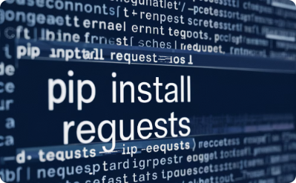
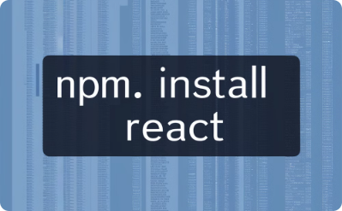

Popular CLI Applications
Git
Bash
Pip
NPM
A popular version control system widely used by developers to manage code changes. It provides various commands for tracking, branching, merging, and committing code.
A powerful command-line interpreter used on Linux and macOS systems. It provides a wide range of commands for navigating the file system, managing processes, and executing scripts.
A package manager for Python that simplifies installing and managing Python packages. It's a crucial tool for developers working with Python libraries and frameworks.
A package manager for JavaScript and Node.js that allows developers to install, manage, and share code packages for building web applications.

Slide 3





History and Evolution of CLI
Early Beginnings
The roots of CLIs trace back to early computers, where users interacted with machine language through punched cards or teletypewriters. These systems were primitive and required technical expertise to operate.
Rise of Operating Systems
The development of operating systems like Unix and DOS introduced the concept of command-line shells, which provided more user-friendly interfaces and standardized commands.
GUI Era
The emergence of graphical user interfaces (GUIs) in the 1980s challenged the dominance of CLIs. However, CLIs remained essential for tasks requiring automation and power.
Modern Revival
CLIs have experienced a resurgence in popularity due to the rise of scripting languages, cloud computing, and DevOps practices. They offer a level of control and flexibility not always available in GUIs.

Slide 4
Advantages of CLI Applications
Efficiency and Automation
Power and Control
Flexibility and Customization
Remote Access and Management
CLIs provide fine-grained control over system processes, allowing users to access and manipulate low-level settings and configurations that might be inaccessible through GUIs.
CLIs excel in automating repetitive tasks. Scripts can be written to perform complex operations in a single command, saving time and reducing human error.
CLIs are highly adaptable and can be customized to suit specific workflows. Users can create aliases and scripts to tailor commands to their needs.
CLIs are essential for managing remote servers and systems. They enable users to access and control machines from anywhere with an internet connection.

Slide 5

CLI vs GUI
CLI
1
Text-based interface.
Provides power and flexibility.
GUI
2
Graphical user interface.
Offers visual interaction.
Differences
3
Input methods and user experience.
CLI for automation, GUI for visual tasks.

Slide 6




Key Python Libraries for CLI Development
argparse
click
typer
fire
A built-in Python library for parsing command-line arguments. It's widely used and offers a straightforward approach to defining and handling options and arguments.
A popular third-party library that provides a more sophisticated and expressive way to build CLIs. It offers features like nested commands, automatic help generation, and support for options with complex types.
A modern CLI library based on type hints. It leverages Python's type system to automatically generate command-line argument parsing logic, making CLI development more intuitive and type-safe.
A library that uses introspection to automatically generate CLIs from Python functions and classes. It's ideal for quickly creating simple CLIs without writing extensive parsing code.

Slide 7
Comparison of argparse, click, typer, and fire
argparse
click
Python's built-in library for argument parsing. Simple to use, good for basic CLIs.
A popular third-party library with a more advanced API for building complex CLIs.
typer
fire
Leverages type hints to simplify CLI development and improve type safety.
Uses introspection to generate CLIs automatically from Python functions, ideal for rapid prototyping.

Slide 8
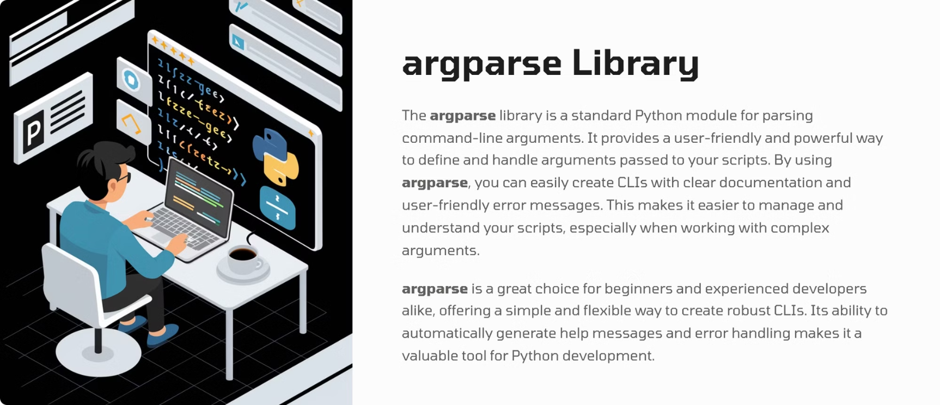
argparse

Slide 9
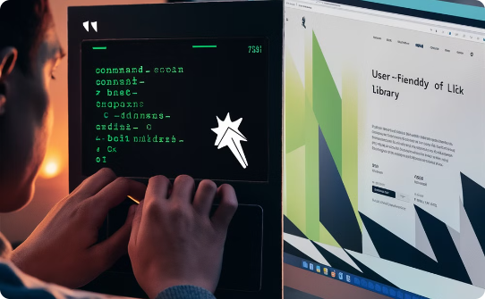



click Library
User-Friendly Design
Rich Features
Flexibility and Power
The click library emphasizes ease of use and intuitive command-line interfaces, making it simple for users to interact with your applications.
The click library offers a wide range of features, such as argument parsing, help messages, and nested commands, empowering developers to build advanced CLIs.
Click offers flexibility for customizing your CLIs, enabling developers to tailor their applications to specific needs and scenarios.

Slide 10
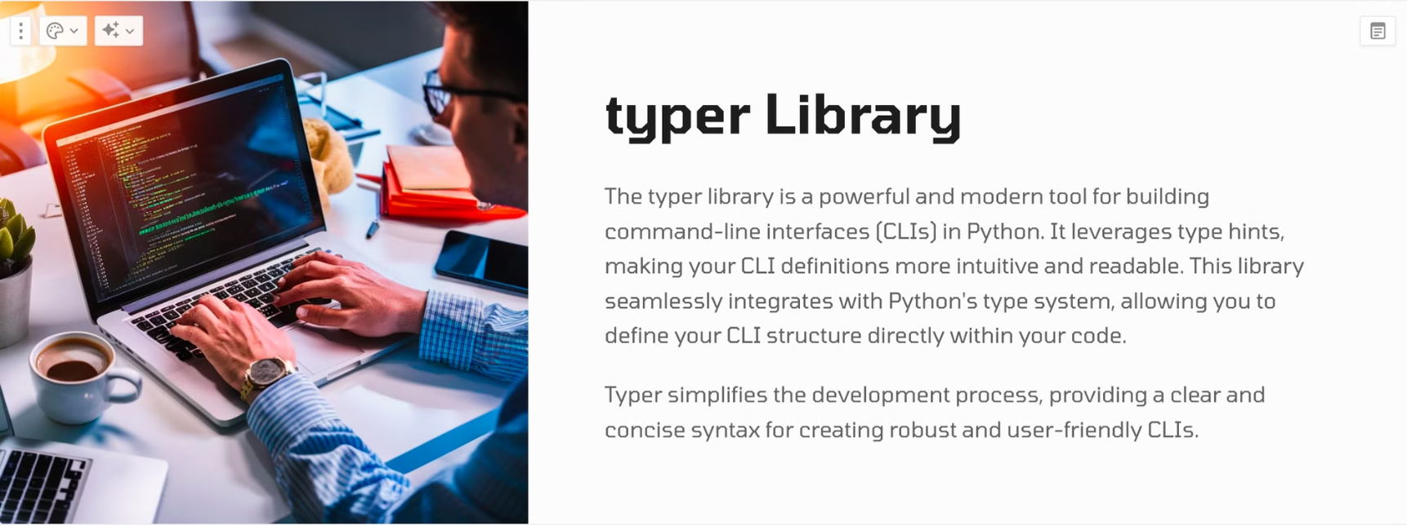

typer

Slide 11
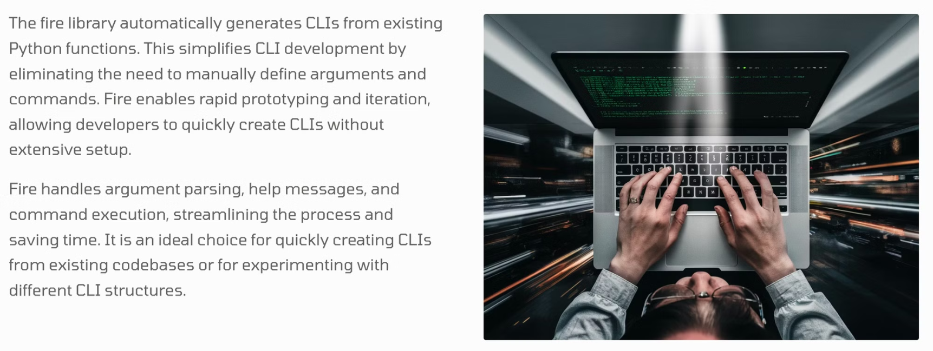

fire

Slide 12
Comparison of CLI Libraries
argparse
click
typer
fire
Standard library module. Simple and efficient for basic argument parsing. Provides built-in help messages and error handling.
Popular and feature-rich. Creates intuitive and user-friendly CLIs. Offers advanced features like nested commands and context-sensitive help.
Modern library leveraging type hints. Provides a concise and readable syntax for defining CLIs. Integrates seamlessly with Python's type system.
Generates CLIs automatically. Ideal for rapid prototyping and creating CLIs from existing code. Simplifies development and eliminates manual argument parsing.

Slide 13

Structure of a Typical CLI Application
Entry Point
1
The starting point of the application, often defined as a main function. It sets up the environment, initializes required libraries, and initiates the argument parsing process.
2
Argument Parsing
Processes command-line arguments, including flags, options, and positional arguments, to configure the behavior of the application based on user input.
Main Logic
3
The core functionality of the application, where the provided arguments are used to perform specific tasks, manipulate data, or interact with external systems.
4
Output Formatting
Presents results and messages to the user in a clear and readable format, ensuring that the output is informative and easy to understand.
Error Handling
5
Manages potential errors that can occur during execution, such as invalid arguments, unexpected data, or system failures, providing informative error messages to the user.

Slide 14




Entry Point and Argument Parsing
The entry point of a CLI application is the main function that acts as the starting point for execution. It's where the program begins running.
Entry Point
1
The main function of the CLI application
Argument Parsing
2
Process user input and options
Initialization
3
Setup and configuration
Argument parsing involves analyzing the command-line arguments provided by the user. It interprets options, flags, and positional arguments to determine how the CLI should execute its functions.

Slide 15

Main Logic and Error Handling
1
Main Logic
The core functionality of the CLI application.
2
Argument Processing
Utilizes the parsed arguments to perform specific tasks.
3
Data Manipulation
Processes data, interacts with external systems.
4
Error Handling
Manages errors, provides informative messages.
The main logic section is responsible for executing the core functionality of the CLI application. It takes the arguments processed during the parsing stage and uses them to perform the intended tasks. This may involve manipulating data, interacting with external systems, or generating outputs.
Robust error handling is essential for a reliable CLI application. The main logic section should incorporate mechanisms to anticipate and handle potential errors, such as invalid arguments, unexpected data, or system failures. Providing clear and informative error messages to the user is crucial for a user-friendly experience.

Slide 16





Output Formatting
Plain Text
1
Simple and straightforward.
Structured Output
2
Tables, lists, or JSON.
Progress Indicators
3
Show task completion or status.
Visual Enhancements
4
Colors, styling, or graphics.
The way a CLI application presents its output significantly impacts user experience. Clear and well-formatted output makes the information easily understandable and actionable. Effective output formatting involves choosing the appropriate presentation style, incorporating visual cues, and considering the target audience.

Slide 17
Best Practices in CLI Development
1
Clear and Concise Syntax
2
User-Friendly Help
Use simple commands and intuitive arguments for easy understanding and usability.
Provide comprehensive help messages with examples for each command and option.
3
Error Handling and Feedback
4
Consistent Formatting
Handle errors gracefully, providing informative messages to guide users.
Maintain consistent output formatting for readability and user expectations.

Slide 18



Enhancing User Experience
User-Friendly Help
Informative Feedback
Input Suggestions
Progress Indicators
Provide clear and concise help messages with examples for easy understanding.
Give users timely and relevant feedback on their commands, including progress updates and error messages.
Offer autocompletion and suggestions for commands and arguments, reducing errors and improving efficiency.
Display visual indicators like progress bars to show the status of long-running tasks.

Slide 19





Common Use Cases for CLI Applications
System Administration
Software Development
Data Manipulation and Analysis
Web Development
CLI applications are essential for system administration tasks, managing servers, and automating repetitive operations.
Developers use CLI tools for building, testing, and deploying software, interacting with version control systems, and managing project dependencies.
CLIs are widely used for web development tasks, including building websites, deploying applications, and managing servers.
CLI tools are powerful for data processing, performing complex calculations, transforming datasets, and generating reports.

Slide 20
Real-World CLI Application Examples
1
Git
2
Docker
Git is a widely used version control system with a powerful command-line interface for managing code repositories, branching, merging, and committing changes.
Docker, a containerization platform, provides CLI tools for building, running, and managing containerized applications.
3
Kubernetes
4
AWS CLI
Kubernetes, a container orchestration platform, offers a rich CLI for managing containerized applications, deployments, and scaling.
The AWS Command Line Interface (CLI) allows users to interact with Amazon Web Services (AWS), managing resources, configuring services, and automating tasks.

